Slide 1
Market Segmentation and Analysis
Toran V Athani
21BCE2405
Guide Name:
Prof. Pushpa Gothwal

Slide 2
Aim/Objective
The primary aim of such a project is to identify distinct customer segments based on their behaviours, preferences, and demographics. By understanding these segments, businesses can tailor their marketing strategies, product offerings, and customer experiences to better meet the specific needs of each group.
Specific objectives include:
1)Customer Segmentation 4)Product Development
2)Customer Profiling 5)Customer Retention
3)Targeted Marketing 6)Predictive Analytics

Slide 3
Motivation
Businesses are increasingly recognizing the value of data-driven insights to improve their operations and customer relationships. Market segmentation, powered by machine learning, offers several key motivations:
Enhanced Customer Understanding:
Deeper Insights: Uncover hidden patterns and trends in customer behaviour that traditional methods might miss.
Personalized Experiences: Tailor products, services, and marketing messages to individual preferences.
Optimized Marketing Strategies:
Targeted Campaigns: Allocate marketing resources effectively by focusing on high-value segments.
Increased ROI: Improve campaign performance by reducing wasted effort and maximizing conversions.

Slide 4
Literature Review
Author(s) and Year | Focus Area | Methodology | Key Findings
Sotomayor Vidal et al. | Digital marketing in higher education student recruitment | Case study | Demonstrated the impact of digital marketing strategies on attracting students in the private sector.
Hemsley-Brown (2020) | Higher education market segmentation | Conceptual overview | Highlighted the need for nuanced segmentation in higher education to address diverse student needs.
Davari et al. (2019) | Professional education market segmentation | Data mining | Applied data mining to identify distinct segments and their preferences in professional education.
Lozano et al. (2021) | Social inequalities in higher education segmentation | Empirical study | Revealed how market segmentation reflects social inequalities in Colombia’s education system.
Chen & Hsiao (2009) | Student behavior in school selection | Market segmentation theory | Explored factors influencing students' decisions when selecting schools and departments.
Casas-Rosal et al. (2023) | Food market segmentation | Multicriteria decision-making approach | Developed a segmentation model based on consumer preferences in the food market.
Canterbury (2000) | Challenges in higher education marketing | Conceptual analysis | Identified challenges and strategies for effective higher education marketing.
Zhao et al. (2023) | Corruption and market segmentation | Empirical analysis | Analyzed the impact of corruption on market segmentation and environmental outcomes in China.
Lambert (2023) | Labor market segmentation in the context of the Great Resignation | Case study | Studied labor market dynamics during the Great Resignation, identifying key segmented groups.

Slide 5
Literature Review
Author(s) and Year | Focus Area | Methodology | Key Findings
Rizvi (2023) | Internationalization of higher education | Conceptual discussion | Discussed the role of diaspora in higher education internationalization strategies.
Aktan & Kaplan (2023) | Mindfulness in higher education | Theoretical framework | Proposed redesigning higher education with mindfulness as a focus.
Rajput & Singh (2023) | E-commerce customer segmentation | K-means clustering | Demonstrated effective segmentation using clustering algorithms for online retail.
Huang (2023) | Slow food market segmentation | Cluster analysis | Identified market segments for slow food experiences in hospitality.
Vieri et al. (2023) | Telecommunications customer segmentation | Exclusive clustering | Highlighted distinct customer groups for targeted marketing in telecom.
Kumar (2023) | Shopping mall user segmentation | K-means clustering | Explored customer segmentation for better service personalization in malls.
Kim & Irakoze (2023) | Green housing market segmentation | Cluster analysis | Identified segments willing to pay a premium for green-certified housing.
Zhu & Liu (2023) | Personalized preference learning | Segmentation strategy | Proposed a segmentation approach for sparse consumer data in personalized services.

Slide 6
Gaps Identified
Category | Identified Gaps | Impact | Recommendations
Diverse Dataset Handling | Inability to generalize across datasets with varying characteristics. | Skewed results, inaccurate segmentation, reduced model reliability. | Develop robust algorithms capable of handling diverse, high-dimensional data without over/underfitting.
Real-Time Data Integration | Lack of incorporation of dynamic data streams into segmentation models. | Missed opportunities to adapt to real-time changes in customer behavior or external factors. | Integrate machine learning models with real-time data pipelines for dynamic segmentation.
Model Interpretability | Machine learning models operate as "black boxes," limiting trust and understanding of segmentation decisions. | Reduced business trust and adoption of segmentation strategies. | Develop interpretable models that explain how and why customer groups are identified.
Niche Market Applications | Limited application of segmentation techniques to specialized industries (e.g., luxury, medical, high-tech). | Missed opportunities to tailor strategies to niche market dynamics. | Conduct research on segmentation strategies specific to niche markets.
Integration of External Factors | Failure to incorporate external influences (e.g., economic shifts, cultural trends, unforeseen events) into segmentation models. | Incomplete understanding of consumer behavior shifts. | Enhance models to process and integrate dynamic, multi-source data to capture external factors.
Ethical Concerns | Insufficient focus on data privacy, consent, and fairness in automated segmentation processes. | Risk of non-compliance with regulations, loss of consumer trust, and ethical controversies. | Establish ethical guidelines ensuring fairness, transparency, and regulatory compliance.

Slide 7
Problem Formulation:
Background: Market segmentation is crucial for targeted marketing strategies but faces limitations in leveraging machine learning to address dynamic and diverse consumer needs.
Key Challenges:
Diverse Dataset Handling: Models struggle to generalize across varied data distributions.
Real-Time Data Integration: Lack of dynamic adaptation to evolving consumer behavior.
Niche Market Gaps: Insufficient focus on specialized industries.
Evaluation Metrics: Limited frameworks for assessing long-term impacts.
Problem Statement: "Current machine learning methods for market segmentation are insufficiently equipped to handle diverse datasets, adapt to real-time data, provide transparency, and address ethical concerns, limiting their effectiveness and trustworthiness in dynamic business environments."

Slide 8
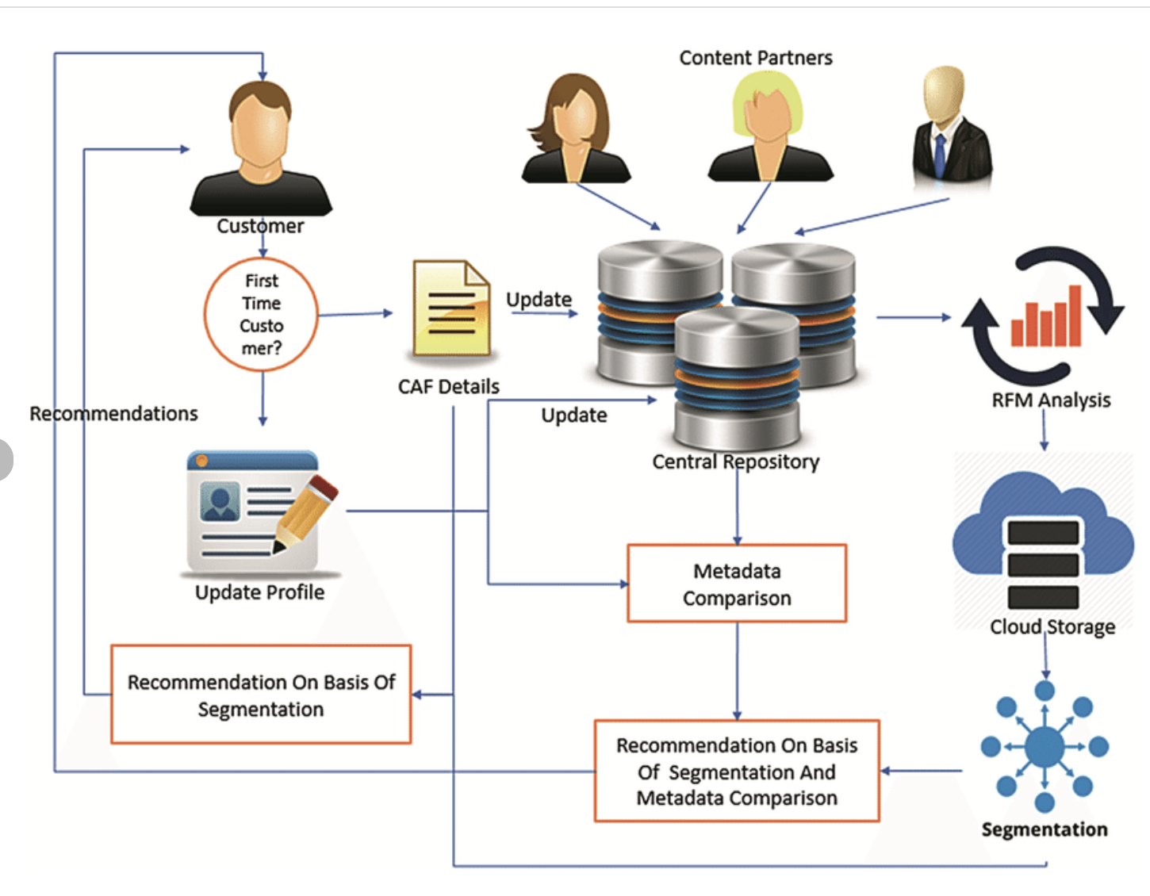
System Architecture

Slide 9
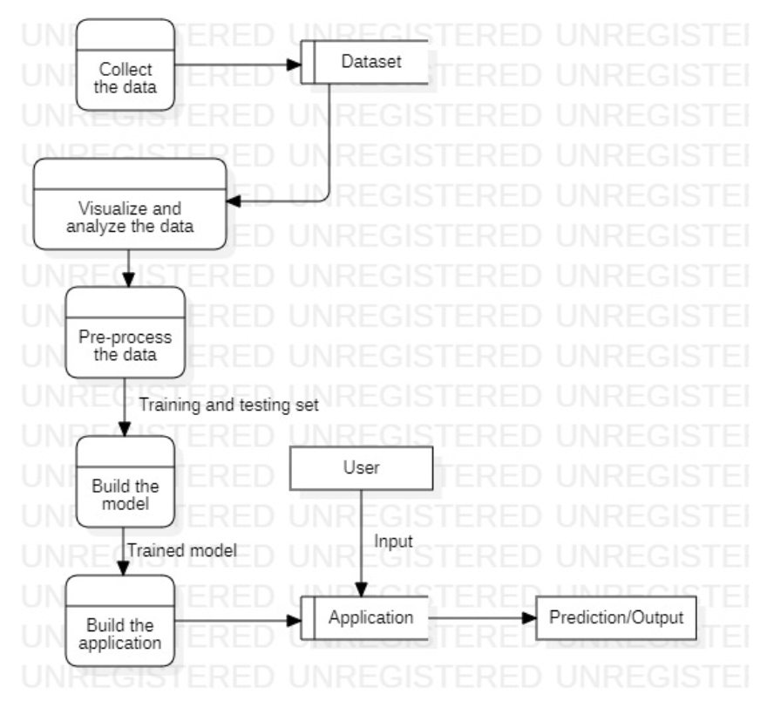
Data flow diagram

Slide 10
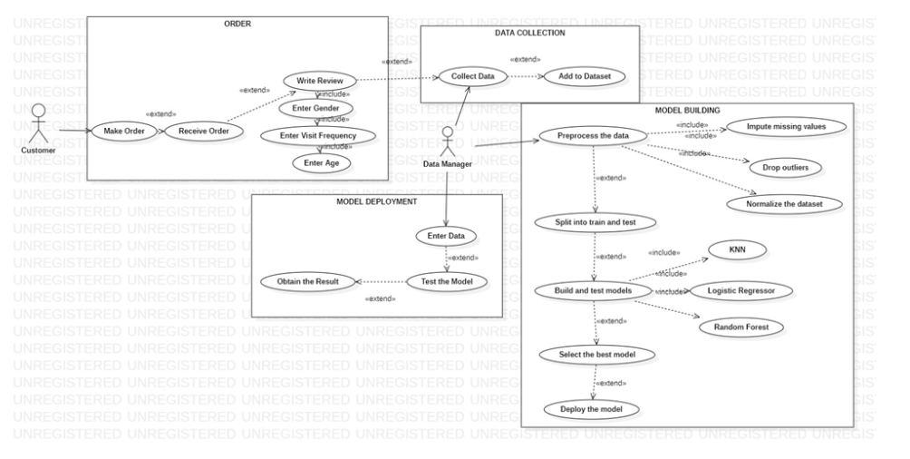
Use case Diagram

Slide 11
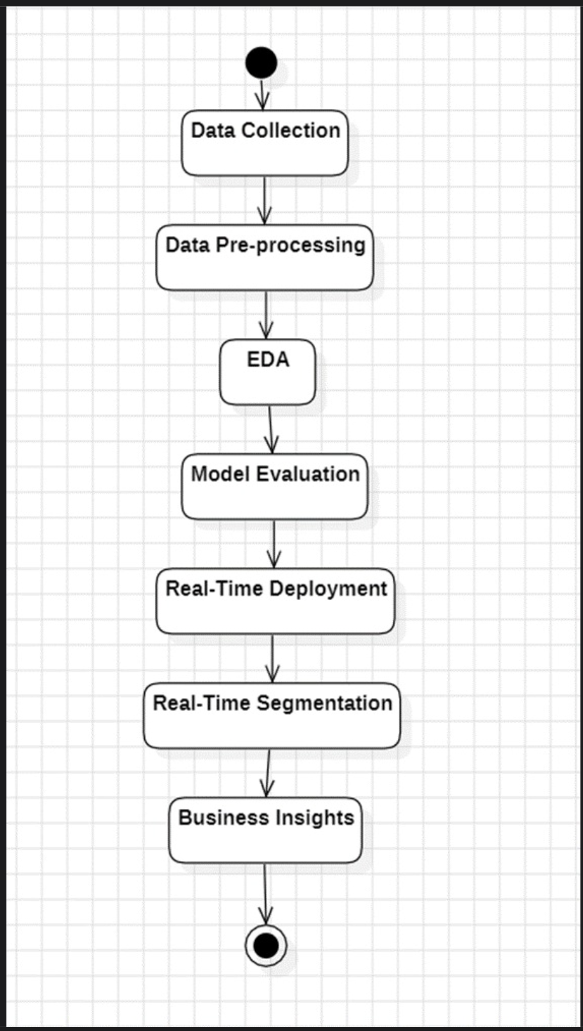
Activity diagram

Slide 12
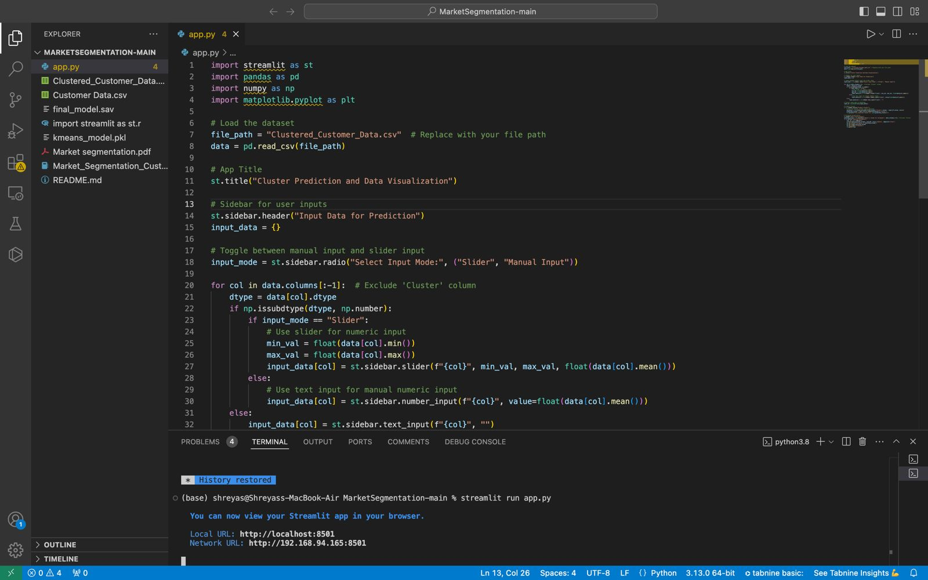
Experimental Result and Analysis

Slide 13
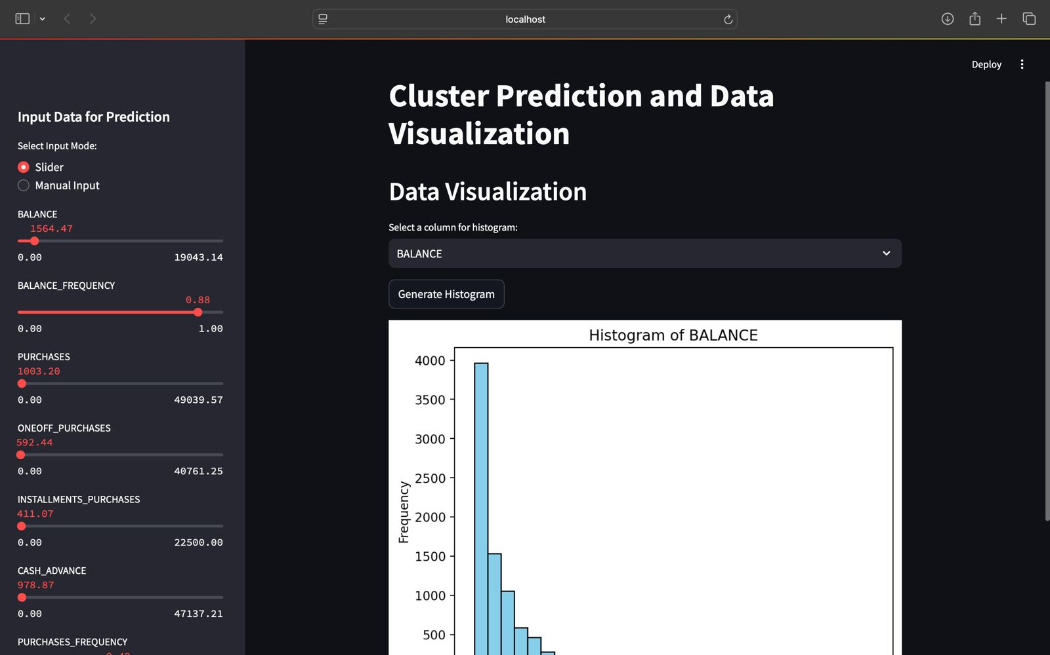
Experimental Result and Analysis

Slide 14
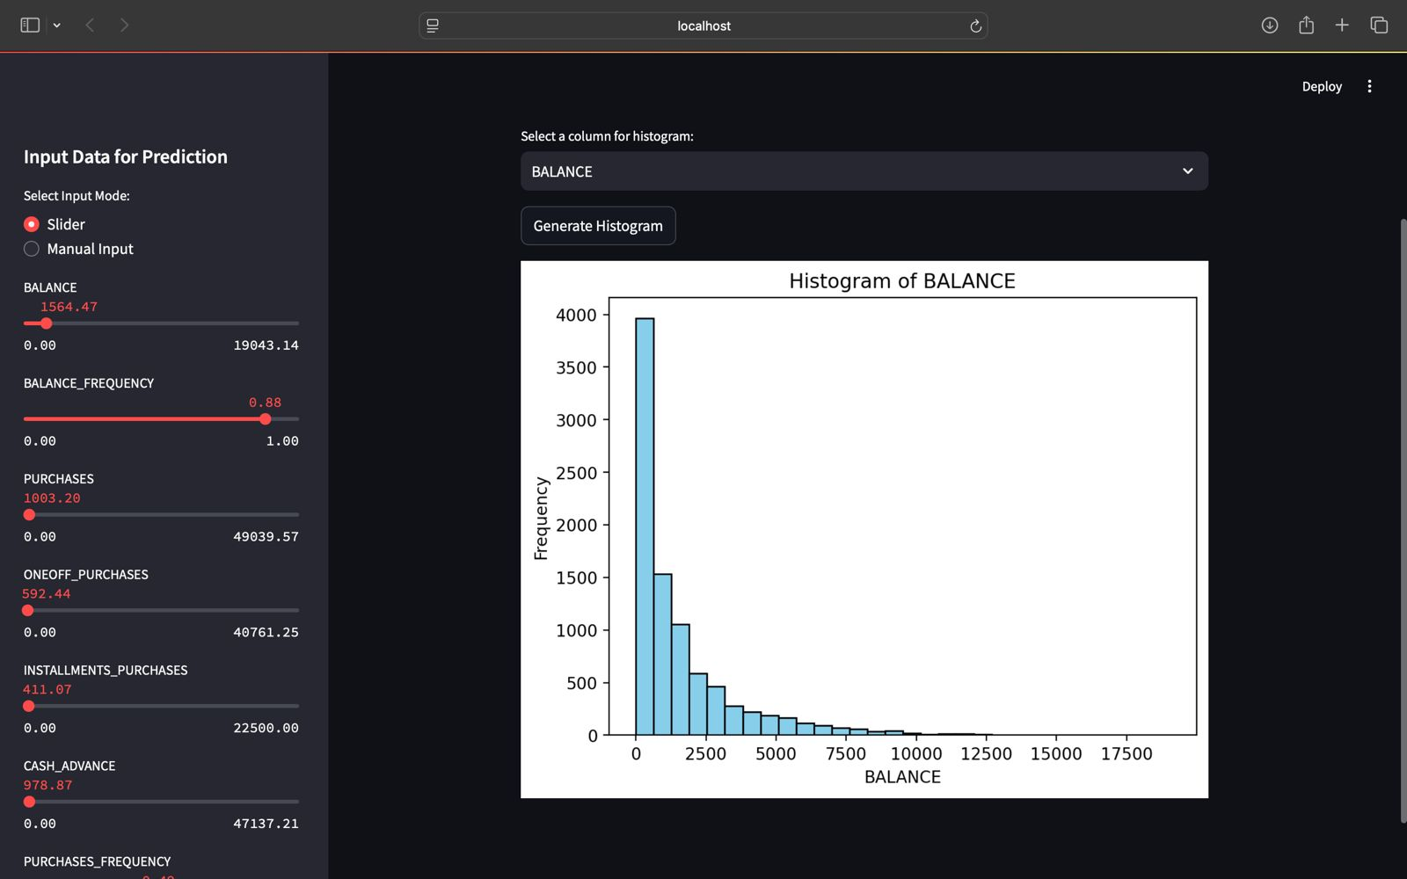
Experimental Result and Analysis

Slide 15
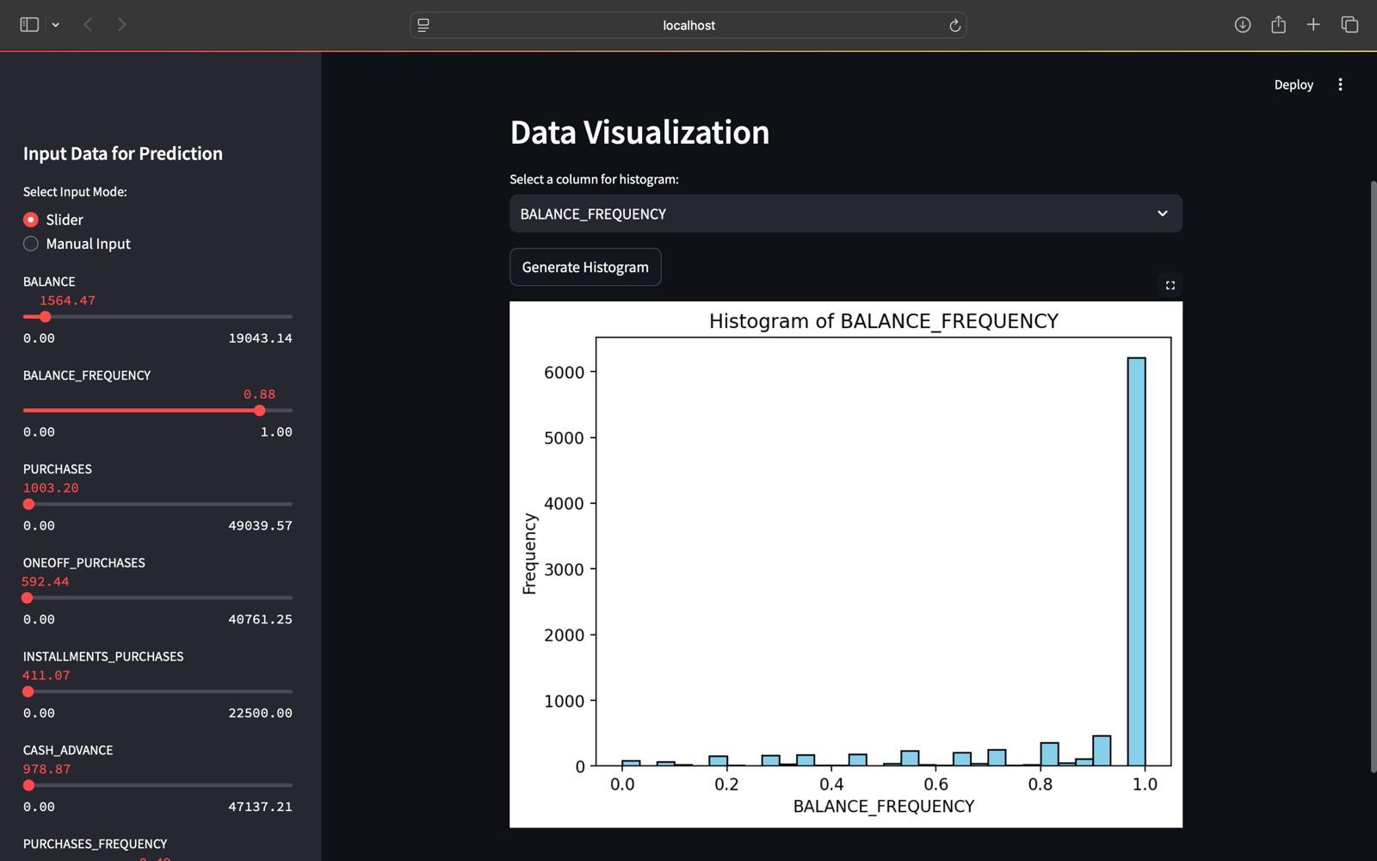
Experimental Result and Analysis

Slide 16
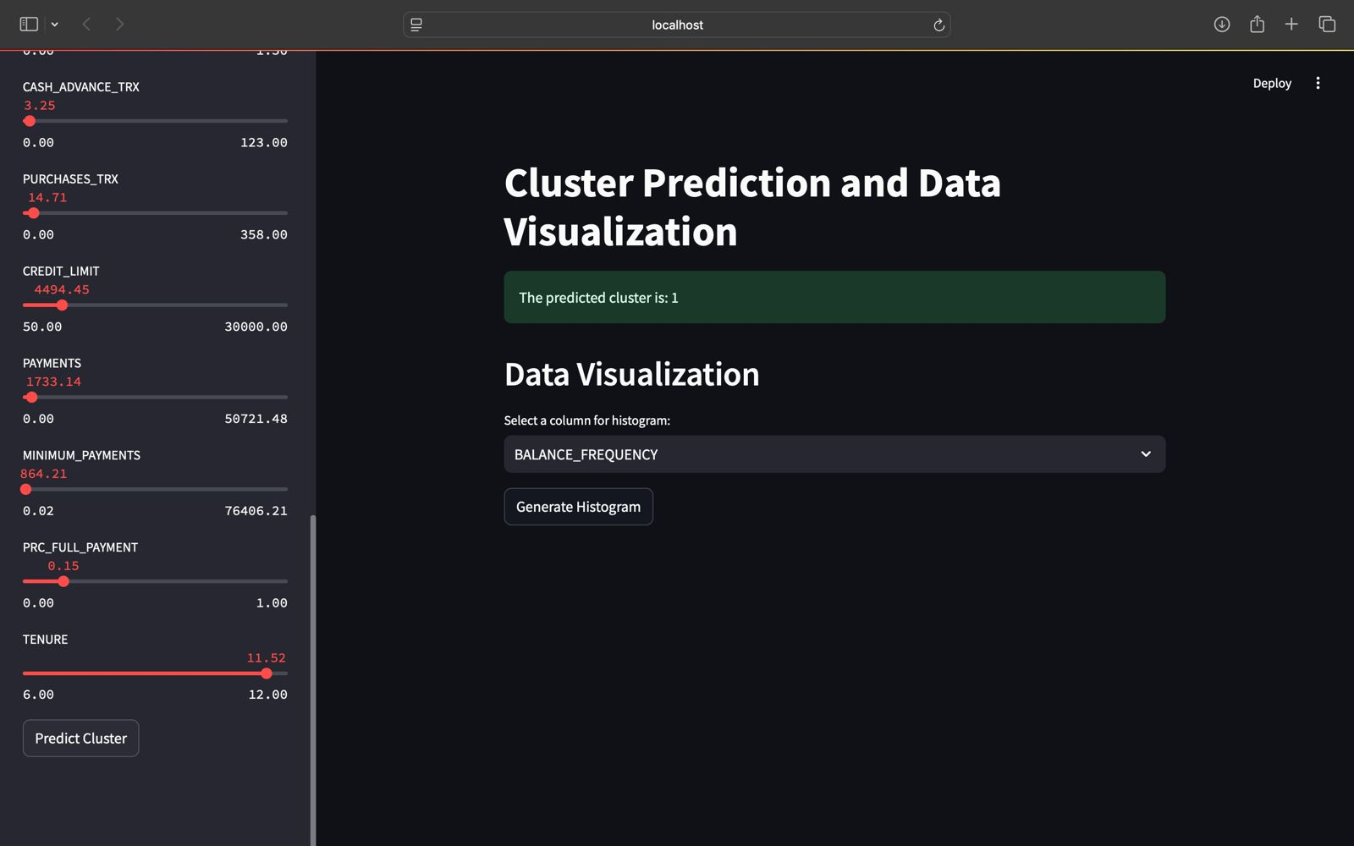
Experimental Result and Analysis

Slide 17
Conclusion and Future development
Summary | Business Implications | Future Work
1. Machine learning techniques (e.g., k-means, DBSCAN, hierarchical clustering) identified distinct market segments. | 1. Marketing strategies can be optimized by targeting specific consumer segments with tailored offers. | 1. Explore advanced clustering algorithms (e.g., deep learning-based) to uncover more complex consumer patterns.
2. Segments with unique characteristics were discovered, providing valuable insights into consumer behavior. | 2. Understanding segments aids in resource allocation, focusing efforts on the most profitable or strategically important groups. | 2. Incorporate external data (e.g., social media sentiment, market trends) to enrich segmentation analysis and improve decision-making.
3. Marketing campaigns can be developed to align with consumer preferences, increasing engagement and conversion rates. | 3. High-value segments can be targeted with personalized offers, while price-sensitive segments benefit from discounts and promotions. | 3. Longitudinal studies can track segment stability over time, offering insights into how consumer preferences evolve.
4. Product development can be guided by segment-specific needs, improving product-market fit. | 4. Customer retention strategies can be optimized by offering products or services that meet the distinct needs of each segment. | 4. Dynamic segmentation strategies should be developed to adapt to changing consumer behaviors.
5. Future research could explore deeper machine learning techniques to detect more granular patterns within consumer data. | 5. Resource allocation decisions can be improved by focusing on the most profitable or high-potential segments. | 5. Investigate the impact of changing market trends on customer segments to refine marketing strategies over time.
6. Consider integrating external data (e.g., social media sentiment) for a more holistic view of consumer behavior. | 6. Businesses can leverage segment-based insights for more precise targeting, reducing wasted marketing efforts. | 6. Enhance the segmentation model's flexibility by incorporating real-time data for adaptive strategy formulation.

Slide 18
References
Sotomayor Vidal, A., Mini-Cuadros, D. A., Quiroz-Flores, J. C. (n.d.). The Influence of Digital Marketing on the Student Recruitment Process in the Private Higher Education Sector in Peru'.
Hemsley-Brown, J. (2020). Higher education market segmentation. The International Encyclopedia of Higher Education Systems and Institutions, 711-713.
Davari, M., Noursalehi, P., Keramati, A. (2019). Data mining approach to professional education market segmentation: a case study. Journal of Marketing for Higher Education, 29(1), 45-66.
Lozano, F. A. M., Cruz Pulido, J. M., Garcia Rodriguez, J. F. (2021). The market segmentation of higher education in Colombia reveals social inequalities. Cogent Education, 8(1), 1877885.
Chen, Y.-F., Hsiao, C.-H. (2009). Applying market segmentation theory to student behavior in selecting a school or department. New Horizons in Education, 57(2), 32- 43.
Casas-Rosal, J. C., Segura, M., Maroto, C. (2023). Food market segmentation based on consumer preferences using outranking multicriteria approaches. International Transactions in Operational Research, 30(3), 1537-1566.
Canterbury, R. M. (2000). Higher education marketing: A challenge. Journal of Marketing for Higher Education, 9(3), 15-24.
Zhao, J., Shen, J., Yan, J., Yang, X., Hao, Y., Ran, Q. (2023). Corruption, market segmentation and haze pollution: empirical evidence from China, Journal of Environmental Planning and Management, 66(3), 642-664.
Lambert, T. E. (2023). The Great Resignation in the United States: A Study of Labor Market Segmentation, Forum for Social Economics, 1- 14.
Rizvi, F. (2023). Internationalization of Higher Education and the Advantage of Diaspora. International Higher Education, 113, 16-17.

Slide 19
References
Aktan, D., Demirbag Kaplan, M. (2023). Re-designing Higher Education for Mindfulness: Conceptualization and Communication, In The Sustainable University of the Future: Reimagining Higher Education and Research (pp. 63-82). Springer.
Rajput, L., Singh, S. N. (2023). Customer Segmentation of E- commerce data using K-means Clustering Algorithm. 2023 13th International Conference on Cloud Computing. Data Science Engineering (Confluence), 658-664,
Huang, T.-Y. T. (2023). Market Segmentation Analysis of Slow Food Experiences at a Winery. In Advances in Hospitality and Leisure (Vol. 18, pp. 57-69). Emerald Publishing Limited.
Vieri, J. K., Munandar, T. A., Srisulistiowati, D. B. (2023). Exclusive Clustering Technique for Customer Segmentation in National Telecommunications Companies. International Journal of Information Technology and Computer Science Applications, 1(1), 51-57.
Kumar, A. (2023). Customer Segmentation of Shopping Mall Users Using K-Means Clustering. In Advancing SMEs Toward E-Commerce Policies for Sustainability (pp. 248-270). IGI Global.
Kim, D. H., Irakoze, A. (2023) Identifying Market Segment for the Assessment of a Price Premium for Green Certified Housing: A Cluster Analysis Approach. Sustainability, 15(1), 507.
Zhu, T., Liu, Y. (2023). Learning personalized preference. A segmentation strategy under consumer sparse data. Expert Systems with Applications, 215, 119333.
Singhal, S., Jena, M. (nd). A study on WEKA tool for data preprocessing, classification and clustering.
Singhal, S., Ahuja, L, Monga, H. (2020). State of The Art of Machine Learning for Product Sustainability. 2020 2nd International Conference on Advances in Computing, Communication Control and Networking (ICACCCN), 197-202 https://doi.org/10.1109/ICACCCNS1052.2020.9362746

Slide 20
References
Weblinks:
https://neptune.ai/blog/customer-segmentation-using-machine-learning/
https://deepchecks.com/glossary/segmentation-in-machine-learning/
https://idiomatic.com/blog/customer-segmentation-machine-learning/
Book:
"Market Segmentation: How to Do It and How to Profit from It" by Malcolm McDonald and Ian Dunbar.
"Data Science for Marketing Analytics" by Tommy Blanchard, Debasish Behera, and Pranshu S. Choudhary.
"Segmentation, Revenue Management and Pricing Analytics" by Tudor B. Stone.

